Slide 1
How to make video

Slide 2
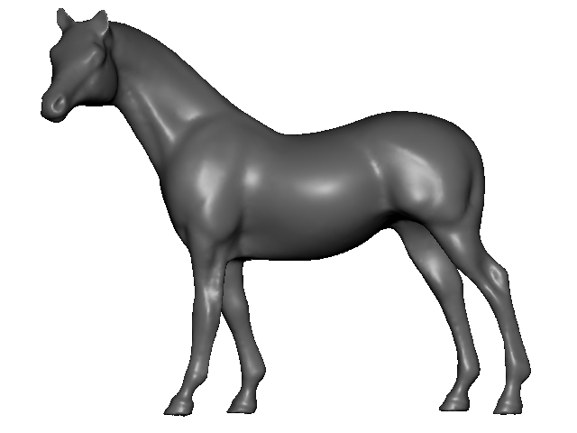
Slide 2

Slide 3
Slide 3

